Slide 1


The involved nodes
UE
eNodeB
nodeB
UE
X
MME
S-GW
P-GW
GGSN
SGSN
RNC
Assumption: the LTE and the UMTS networks belong to the same operator
→ P-GW = GGSN (they are the same device)
LTE
UMTS

Slide 2
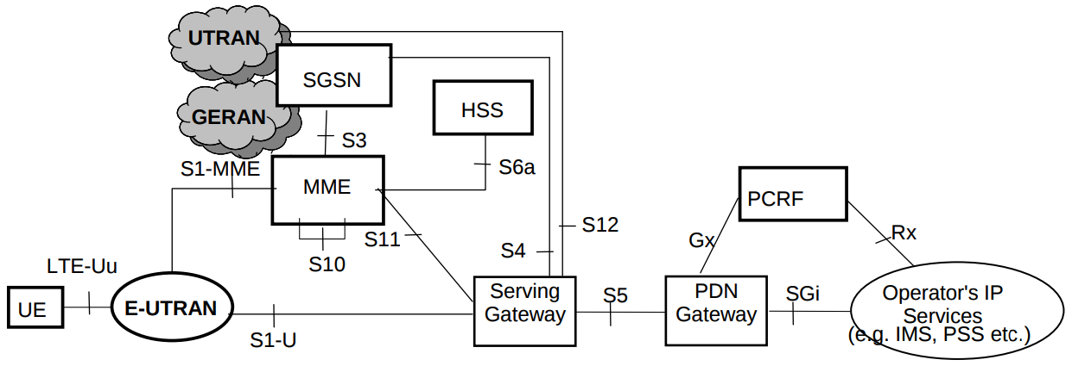
The involved nodes

Slide 3
Preparation phase
UE
eNodeB
nodeB
MME
S-GW
P-GW
SGSN
RNC
Uplink and Downlink User Plane PDUs
Bearers
GTP tunnels
Before the handover the UE is connected and user
plane PDUs (user data) are being transferred through
the showed path

Slide 4
Preparation phase
UE
eNodeB
nodeB
MME
S-GW
P-GW
SGSN
RNC
1) Handover initiation
Uplink and Downlink User Plane PDUs
2) Handover required
(S1 interface)
Message parameters:
S1AP Cause, Target RNC Identifier, CSG ID,
CSG access mode, Source to Target Transparent Container

Slide 5
Preparation phase
UE
eNodeB
nodeB
MME
S-GW
P-GW
SGSN
RNC
1) Handover initiation
Uplink and Downlink User Plane PDUs
2) Handover required
(S1 interface)
3) Forward relocation request
(S3 interface)
Message parameters:
IMSI, CSG ID, CSG Membership Indication, MM Context,
PDN Connections, Source to Target Transparent Container,
RAN Cause, ISR Supported

Slide 6
Preparation phase
UE
eNodeB
nodeB
MME
S-GW
P-GW
SGSN
RNC
1) Handover initiation
Uplink and Downlink User Plane PDUs
2) Handover required
(S1 interface)
3) Forward relocation request
(S3 interface)
4) Relocation request
(Iu-PS interface)
4a) Relocation request ACK
Message parameters:
4) UE Identifier, Cause, Encryption information RAB to be setup list,
CSG ID, CSG Membership Indication, Source RNC to Target RNC Transparent
Container
4a) Target RNC to Source RNC Transparent Container, RABs setup list,
RABs failed to setup list.

Slide 7
Preparation phase
UE
eNodeB
nodeB
MME
S-GW
P-GW
SGSN
RNC
1) Handover initiation
Uplink and Downlink User Plane PDUs
2) Handover required
(S1 interface)
3) Forward relocation request
(S3 interface)
4) Relocation request
(Iu-PS interface)
4a) Relocation request ACK
5) Forward relocation response
(S3 interface)
Message parameters:
5) Cause, SGSN Tunnel Endpoint Identifier for Control Plane,
SGSN Address for Control Plane, Target to Source Transparent Container,
Address(es) and TEID(s) for User Traffic Data Forwarding

Slide 8
Preparation phase
UE
eNodeB
nodeB
MME
S-GW
P-GW
SGSN
RNC
1) Handover initiation
Uplink and Downlink User Plane PDUs
2) Handover required
(S1 interface)
3) Forward relocation request
(S3 interface)
Message parameters:
6) Address(es) and TEID(s) for Data Forwarding (received in step 5)),
EPS Bearer ID(s)
6a) Cause, Serving GW Address(es) and TEID(s) for Data Forwarding
4) Relocation request
(Iu-PS interface)
4a) Relocation request ACK
5) Forward relocation response
(S3 interface)
6) Create Indirect Data Forwarding Tunnel Request
(S11 interface)
6a) Create Indirect Data Forwarding Tunnel Response

Slide 9
Preparation phase
UE
eNodeB
nodeB
MME
S-GW
P-GW
SGSN
RNC
1) Handover initiation
Uplink and Downlink User Plane PDUs
2) Handover required
(S1 interface)
3) Forward relocation request
(S3 interface)
4) Relocation request
(Iu-PS interface)
4a) Relocation request ACK
5) Forward relocation response
(S3 interface)
6) Create Indirect Data Forwarding Tunnel Request
(S11 interface)
6a) Create Indirect Data Forwarding Tunnel Response

Slide 10
Execution phase
UE
eNodeB
nodeB
MME
S-GW
P-GW
SGSN
RNC
Uplink and Downlink User Plane PDUs
1) Handover command
(s1 interface)
Message parameters:
Target to Source Transparent Container, E-RABs to Release List,
Bearers Subject to Data Forwarding List

Slide 11
Execution phase
UE
eNodeB
nodeB
MME
S-GW
P-GW
SGSN
RNC
Uplink and Downlink User Plane PDUs
1) Handover command
(s1 interface)
2) E-UTRAN HO command
(uu interface)
Message sent through the DCCH downling logical channel
DCCH → DL-SCH → PDSCH

Slide 12
Execution phase
UE
eNodeB
nodeB
MME
S-GW
P-GW
SGSN
RNC
Uplink and Downlink User Plane PDUs
1) Handover command
(s1 interface)
2) E-UTRAN HO command
(uu interface)
3) UTRAN lu Access procedures
3a) Handover to UTRAN complete
(uu – Iub interfaces)
Sending of user uplink data is now possible

Slide 13
Execution phase
UE
eNodeB
nodeB
MME
S-GW
P-GW
SGSN
RNC
Uplink and Downlink User Plane PDUs
1) Handover command
(s1 interface)
2) E-UTRAN HO command
(uu interface)
3) UTRAN lu Access procedures
3a) Handover to UTRAN complete
(uu – Iub interfaces)
Uplink user data
If direct forwarding applies
Downlink user data
If indirect forwarding applies
(Passing through SGSN if direct tunnel is not used)

Slide 14
Execution phase
UE
eNodeB
nodeB
MME
S-GW
P-GW
SGSN
RNC
If direct forwarding applies
(Passing through SGSN if direct tunnel is not used)
If indirect forwarding applies
4) Relocation complete
(Iu-ps interface)

Slide 15
Execution phase
UE
eNodeB
nodeB
MME
S-GW
P-GW
SGSN
RNC
If direct forwarding applies
(Passing through SGSN if direct tunnel is not used)
If indirect forwarding applies
4) Relocation complete
(Iu-ps interface)
5) Forward Relocation Complete notification
(s3 interface)
5a) Forward Relocation Complete ACK

Slide 16
Execution phase
UE
eNodeB
nodeB
MME
S-GW
P-GW
SGSN
RNC
If direct forwarding applies
(Passing through SGSN if direct tunnel is not used)
If indirect forwarding applies
4) Relocation complete
(Iu-ps interface)
5) Forward Relocation Complete notification
(s3 interface)
5a) Forward Relocation Complete ACK
6) Modify Bearer Request
(s4 interface)
Message parameters:
SGSN Tunnel Endpoint Identifier for Control Plane, NSAPI(s),
SGSN Address for Control Plane, SGSN Address(es) and TEID(s) for
User Traffic for the accepted EPS bearers (if Direct Tunnel is not used)
or RNC Address(es) and TEID(s) for User Traffic for the accepted EPS bearers
(if Direct Tunnel is used), ISR Activated.

Slide 17
Execution phase
UE
eNodeB
nodeB
MME
S-GW
P-GW
SGSN
RNC
If direct forwarding applies
(Passing through SGSN if direct tunnel is not used)
If indirect forwarding applies
4) Relocation complete
(Iu-ps interface)
5) Forward Relocation Complete notification
(s3 interface)
5a) Forward Relocation Complete ACK
6) Modify Bearer Request
(s4 interface)
7) Modify Bearer Response
Message parameters:
Cause, Serving GW Tunnel Endpoint Identifier for Control Plane,
Serving GW Address for Control Plane, Protocol Configuration Options, MS Info
Change Reporting Action

Slide 18
Execution phase
UE
eNodeB
nodeB
MME
S-GW
P-GW
SGSN
RNC
If direct forwarding applies
(Passing through SGSN if direct tunnel is not used)
If indirect forwarding applies
4) Relocation complete
(Iu-ps interface)
5) Forward Relocation Complete notification
(s3 interface)
5a) Forward Relocation Complete ACK
6) Modify Bearer Request
(s4 interface)
7) Modify Bearer Response
The new user data path
(passing through SGSN only if direct tunnel is not used)

Slide 19
Execution phase
UE
eNodeB
nodeB
MME
S-GW
P-GW
SGSN
RNC
(passing through SGSN only if direct tunnel is not used)
8) Routing area update procedure
9) Delete Indirect Data Forwarding Tunnel Request

Slide 20
Handover Reject
UE
eNodeB
nodeB
MME
S-GW
P-GW
SGSN
RNC
1) Handover initiation
Uplink and Downlink User Plane PDUs
2) Handover required
(S1 interface)
3) Forward relocation request
(S3 interface)
4) Relocation request
(Iu-PS interface)
4a) Relocation failure
5) Forward relocation response
(S3 interface)
6) Handover preparation failure

